Slide 1

Security
Cryptography

Slide 2
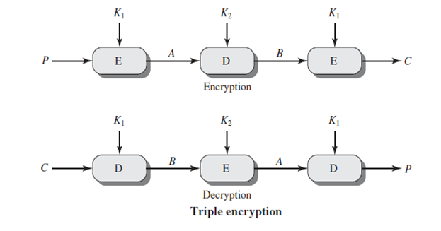
Triple-DES with Two-Keys
would seem to need 3 distinct keys but can use 2 keys with E-D-E sequence.
C = E_{K1}(D_{K2}(E_{K1}(P)))
the use of encryption & decryption stages is equivalent in security, but the chosen E-D-E structure allows for compatibility with single-DES implementations.
if K1=K2 then can work with single DES
no current known practical attacks
suffers from being 3 times slower to run
To break this arrangement using MitM, the attacker needs a computing effort in the order of 2 ^{N+N}, where N is the number of bits in the encryption key.

Slide 3
Modes of Operation
block ciphers (DES /AES) encrypt fixed size blocks unlike the stream ciphers.
There is modes for any block cipher like:
ECB
CBC
In block cipher if the last block isn’t completed where it should have the same size as the others, so we make padding to it. pad either with known non-data value (e.g. nulls)
or pad last block along with count of pad size , we fill the remaining bytes with zeros except the last byte we fill it with the number of dummy bytes so we could remove later.

Slide 4
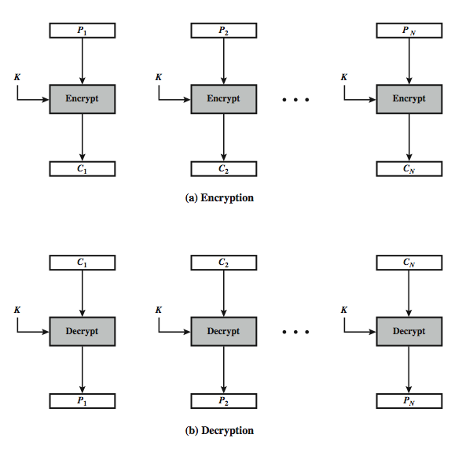
Electronic Codebook Book (ECB)
message is broken into independent blocks which are encrypted
each block is a value which is substituted, like a codebook, hence name
each block is encoded independently of the other blocks
Ci = EK(Pi)
this mode is used for secure transmission of single values
Advantages and Limitations of ECB:
message repetitions may show in ciphertext
if aligned with message block
particularly with data such as graphics
or with messages that change very little, which become a codebook analysis problem
weakness is due to the encrypted message blocks being independent
main use is sending a few blocks of data
Disadvantages: Same plaintext yields same ciphertext

Slide 5
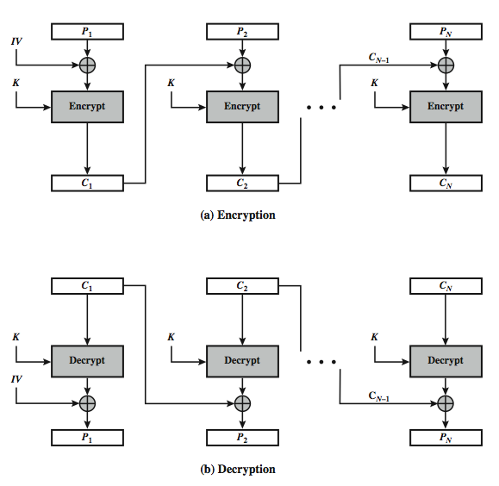
Cipher Block Chaining (CBC)
message is broken into blocks
linked together in encryption operation
each previous cipher blocks is chained with current plaintext block, hence name
use Initial Vector (IV) to start process; i=1,2,3,….
C_{i} = E_{K}(P_{i} ⊕ C_{i-1})
C₀ = IV
Uses: bulk data encryption, authentication
Advantage:
Same plaintext yields different ciphertext
a ciphertext block depends on all blocks before it
any change to a block affects all following ciphertext blocks
Disadvantage:
need Initialization Vector (IV)
which must be known to sender & receiver
if sent in clear, attacker can change bits of first block, and change IV to compensate
hence IV must either be a fixed value (as in EFTPOS)
or must be sent encrypted in ECB mode before rest of message

Slide 6
Stream Modes of Operation
We talked about block modes; we will introduce stream modes that treat any data as a stream of bits then cipher it.
Stream modes convert block cipher into stream cipher
cipher feedback (CFB) mode
allows to operate on smaller plaintext units, e.g. real time data
if a transmission error occurs in one ciphertext block, there will be an error in several blocks of the decrypted plaintext (this is called error propagation)
it uses a complex structure
output feedback (OFB) mode
is simpler than CFB but preferred to operate on entire data blocks
counter (CTR) mode
the Counter (CTR) mode is a variant of OFB, but which encrypts a counter value (hence name) rather than any feedback value
must have a different key & counter value for every plaintext block (never reused)
Encryption is done by XORing plaintext (like one time pad encryption) blocks with random bits.
Use block cipher as some form of pseudo-random number generator to generate the required random bits

Slide 7
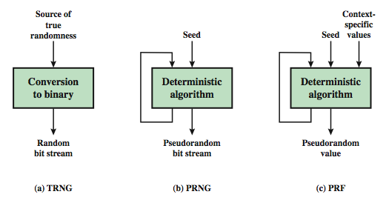
Random Numbers
It has many uses like nonces
in all cases its critical that these values be
statistically random, uniform distribution, independent
unpredictability of future values from previous values
true random numbers (random numbers without patterns) provide this
Pseudorandom Number Generators (PRNGs)
often use deterministic algorithmic techniques to create “random numbers”
although are not truly random , because may it follow a pattern
can pass many tests of “randomness”
It must be fulfilling uniformity, scalability, consistency , unpredictability

Slide 8
Cont.
We can use a block cipher to generate random numbers.
For generated random number we need to make it like true as possible like we make it follow unfixed inputs like the current time with seconds that it continuously changes so always the result will be unpredictable.
Can also use stream cipher to generate random numbers, randomness of stream key destroys statistical properties in message , but must never reuse stream key.

Slide 9
Private/Public Key Cryptography
Private Key Cryptography:
traditional private/secret/single key cryptography uses one key shared by both sender and receiver
if this key is disclosed communications are compromised
also is symmetric, parties are equal (both sender and receiver has the same key)
hence does not protect sender from receiver forging a message & claiming is sent by sender
Its advantage is the fact it is faster.
Public-Key Cryptography:
uses two keys – a public & a private key
asymmetric since parties are not equal
uses clever application of number theoretic concepts to function
complements rather than replaces private key cryptography as we will introduce.
developed to address two key issues:
key distribution – how to have secure communications in general without having to trust a key distribution center with your key
digital signatures – how to verify a message comes intact from the claimed sender

Slide 10
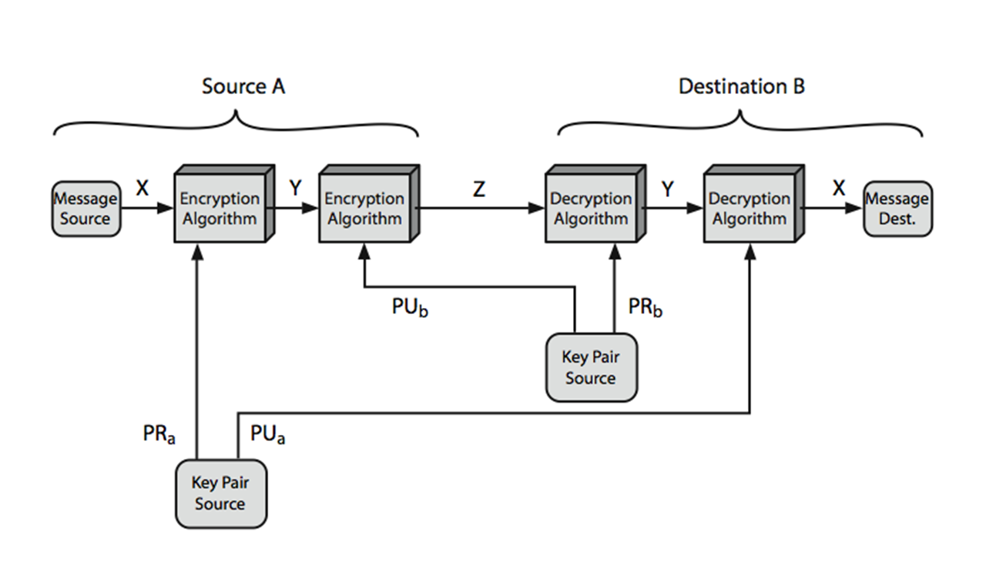
Cont. Public-Key Cryptography
involves the use of two keys:
a public-key, which may be known by anybody, and can be used to encrypt messages, and verify signatures
a related private-key, known only to the recipient, used to decrypt messages, and sign (create) signatures
infeasible to determine private key from public
is asymmetric because those who encrypt messages or verify signatures cannot decrypt messages or create signatures
can classify uses into 3 categories:
encryption/decryption (provide secrecy)
digital signatures (provide authentication)
key exchange (of session keys)
some algorithms are suitable for all uses others are specific to one

Slide 11
Cont. Public-Key Cryptography
Public-Key algorithms rely on two keys where:
it is computationally infeasible to find decryption key knowing only algorithm & encryption key
it is computationally easy to encrypt/decrypt messages when the relevant (encrypt/decrypt) key is known
either of the two related keys can be used for encryption, with the other used for decryption (for some algorithms)
these are formidable requirements which only a few algorithms have satisfied
such algorithms are designed using a one-way function , which means we can’t predict the input which generate the output , so it is a hard problem to compute the origin.
like private key schemes brute force exhaustive search attack is always theoretically possible so we use long keys like 1024 bits.
security relies on a large enough difference in difficulty between easy (encrypt/decrypt) and hard (cryptanalyze) problems
more generally the hard problem is known, but is made hard enough to be impractical to break
requires the use of very large numbers
hence is slow compared to private key schemes

Slide 12
RSA
based on exponentiation in a finite field over integers modulo a prime number
security due to cost of factoring large numbers
Note: factorization takes O(e ^{log n log log n}) operations (hard)
each user generates a public/private key pair by:
selecting two large primes at random: p,q
computing their system modulus n=p.q
note ø(n)=(p-1)(q-1)
selecting at random the encryption key e
where 1<e<ø(n), gcd(e,ø(n))=1 ,gcd is The greatest common factor between the numbers.
solve following equation to find decryption key d
e.d=1 mod ø(n) and 0≤d≤n
publish their public encryption key: PU={e,n}
keep secret private decryption key: PR={d,n}

Slide 13
Cont. RSA
to encrypt a message M the sender:
obtains public key of recipient PU={e,n}
computes: C = Me mod n, where 0≤M<n
to decrypt the ciphertext C the owner:
uses their private key PR={d,n}
computes: M = C^{d} mod n
note that the message M must be smaller than the modulus n (you can divide a long message into smaller blocks if needed)
exponents e, d are inverses, so use Inverse algorithm to compute the other
The ideal value for e is what has MSB only with one and the remaining are Zeros which make the exponential computation faster.

Slide 14
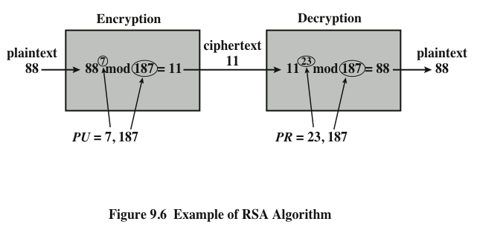
Example RSA Key Obtain (Simplified)
Select primes: p=17 & q=11
Calculate n = pq =17 x 11=187
Calculate ø(n)=(p–1)(q-1)=16x10=160
Select e: gcd(e,160)=1; choose e=7
Determine d: de=1 mod 160 and d < 160 Value is d=23 since 23x7=161= 10x160+1
Publish public key PU={7,187}
Keep secret private key PR={23,187}
given message M = 88 (note: 88<187)
encryption:
C = 88⁷ mod 187 = 11
decryption:
M = 11²³ mod 187 = 88
160 = 1×2×2 ×2 ×2 ×2 ×5
7= 1 ×7
So, e=7 is a correct selection that satisfies the condition since gcd(7, 160) =1
Notes:
Note in real we use too long numbers for random primes.

Slide 15
Diffie-Hellman Key Exchange
A number of commercial products employ this key exchange technique
Purpose is to enable two users to securely exchange a key that can then be used for subsequent symmetric encryption of messages
The algorithm itself is limited to the exchange of secret values
based on exponentiation in a finite field (modulo a prime or a polynomial)
security relies on the difficulty of computing discrete logarithms (hard as factoring)
cannot be used to exchange an arbitrary message rather it can establish a common key known only to the two participants
value of key depends on the participants (and their private and public key information)

Slide 16
Diffie-Hellman Setup
all users agree on global parameters:
large prime integer or polynomial q
α being a primitive root mod q
each user (e.g., A) generates their key
chooses a secret number x_{A} to be the private key:
x_{A} < q
compute their public key:
y_{A} = α^{xA} mod q
each user makes public that key y_{A}
For a prime integer q, the number α will be a primitive root of q if for every positive integer number X < q the computation {Y = α^{X} mod q} will yield a different value for each value of X.
This ensures that for any secret key X_{A} there will be a different public key Y_{A}.
Example: let q=5 and α=3, then for all values of X<5 we have different values of Y.
shared session key for users A,B is K_{AB}:
K_{AB} = α^{xA.xB} mod q
K_{AB} = y_{A}^{xB} mod q (which B can compute)
K_{AB} = y_{B}^{xA} mod q (which A can compute)

Slide 17
Cont. Diffie-Hellman
knowing a public key “Y”, if an attacker needs the corresponding secret private key “X” he must solve a discrete logarithmic equation as follows, which is very difficult when using large numbers.
X = log_{α} Y (mod q)
Diffie-Hellman Example:
users Alice & Bob who wish to swap keys:
agree on prime q=353 and α=3
select random secret keys:
Alice chooses x_{A}=97 & Bob chooses x_{B}=233
compute respective public keys:
y_{A}=3⁹⁷ mod 353 = 40 (Alice)
y_{B}=3²³³ mod 353 = 248 (Bob)
compute shared session key as:
K_{AB}= y_{B}^{xA} mod 353 = 248⁹⁷ = 160 (Alice)
K_{AB}= y_{A}^{xB} mod 353 = 40²³³ = 160 (Bob)

Slide 18
Cont.
Users could create random private/public Diffie-Hellman keys each time they communicate
Users could create a known private/public Diffie-Hellman key and publish in a directory, then consulted and used to securely communicate with them
Vulnerable to Man-in-the-Middle-Attack
an attacker intercepts the messages exchanged between Alice and Bob and builds a shared key with Alice and another shared key with Bob. Both Alice and Bob know nothing and exchange encrypted messages through the attacker.
Authentication of the keys is needed

Slide 19
Elliptic Curve Cryptography (ECC)
majority of public-key cryptography (RSA, D-H) use either integer or polynomial arithmetic with very large numbers/polynomials
using very large numbers/polynomials imposes a significant load in storing and processing keys and messages
an alternative to RSA is to use elliptic curve arithmetic that offers same security with smaller bit sizes
ECC is newer, but not as well analyzed
relies on elliptic curve logarithm problem
compared to factoring, can use much smaller key sizes than with RSA etc.
for similar security ECC offers significant computational advantages
ECC provides the same applications as with RSA and ElGamal algorithms

Slide 20
ElGamal Cryptography
public-key cryptosystem related to D-H
like RSA, this algorithm provides the three basic applications, namely:
encryption/decryption
key sharing
digital signature
with security-based difficulty of computing discrete logarithms, as in D-H
Generally, for public key systems
asymmetric encryption algorithm such as RSA and ECC produce apparently random output
much slower than symmetric algorithms
hence only use to generate a short pseudorandom bit sequence

Slide 21
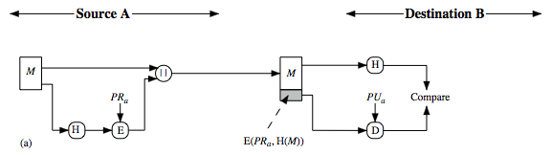
Hash Functions
condenses arbitrary message to fixed size
h = H(M)
usually assume hash function is public
hash used to detect changes to message
want a cryptographic hash function
computationally infeasible to find data mapping to specific hash (one-way property)
computationally infeasible to find two data to same hash (collision-free property)
The cryptographic hash function accepts an input message of arbitrary long size and computes a fixed length hash value that depends on every bit of the input message.
The input message can be any document such as text, image, video, etc.
Other Hash Function Uses:
to create a one-way password file
store hash of password not actual password
for intrusion detection and virus detection
keep & check hash of files on system
pseudorandom function (PRF) or pseudorandom number generator (PRNG)

Slide 22
Attacks on Hash Functions
For an m-bit hash value, attackers have brute-force attacks and cryptanalysis attacks:
a preimage or second preimage attack
find y such that H(y) equals a given hash value. (The level of effort is proportional to 2^{m})
collision resistance attack
find two messages x & y with same hash i.e., H(x) = H(y) (The value 2^{m/2} determines the strength of the hash code against brute-force Birthday Attack)
hence value 2^{m/2} determines strength of hash code against brute-force attacks
128-bits inadequate, 160-bits suspect
Secure Hash Algorithm (SHA) is the most widely used hash algorithm and it has many versions with different sizes like SHA-256, SHA-384, SHA-512
the compression function “F” is the heart of the SHA algorithm.
SHA processes each message in 1024-bit blocks
the compression function “F” consists of 80 rounds

Slide 23
Message Authentication
message authentication is concerned with:
protecting the integrity of a message
validating identity of originator
non-repudiation of origin (dispute resolution)
Message Authentication (Generally)
Protects against active attacks
Verifies received message is authentic
Contents have not been altered
From authentic source
Timely and in correct sequence
Can use conventional encryption
Only sender & receiver share a key

Slide 24
Message Security Requirements
Attacks related to message confidentiality
disclosure (i.e., reading the message contents)
traffic analysis
Attacks related to message authentication
masquerade
Content/ sequence/ timing modification
Source/ destination repudiation

Slide 25
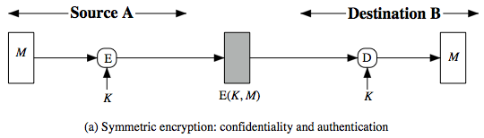
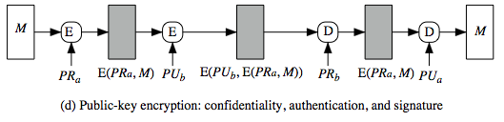
Cont. Message Security Requirements
There are three types of functions that may be used to produce an authenticator:
a hash function
message encryption
if symmetric encryption is used then:
receiver know sender must have created it
since only sender and receiver now key used
know content cannot have been altered
if public-key encryption is used:
encryption provides no confidence of sender since anyone potentially knows public-key
However, if sender signs message using their private-key then encrypts with recipient's public key
have both secrecy and authentication
but at cost of two public-key uses on message
Again, need to recognize corrupted messages
message authentication code (MAC).

Slide 26
Message Authentication Code (MAC)
generated by an algorithm that creates a small fixed-sized block
depending on both message and some key
like encryption though the algorithm need not be reversible
appended to message as a signature
receiver performs same computation on message and checks it matches the MAC
provides assurance that message is unaltered and comes from sender
can also use encryption for secrecy
Generally, use separate keys for each: an encryption key and a MAC key
can compute MAC either before or after encryption
MAC is generally regarded as better done before encryption because in this case the attacker needs to break the encryption key first then breaking the MAC key.
why use a MAC?
sometimes only authentication is needed
sometimes need authentication to persist longer than the encryption (e.g., archival use)
note that a MAC is not a digital signature

Slide 27
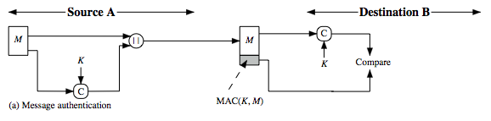
MAC Generation and Verification
MAC is a small fixed-sized block of data
generated from message “M” + secret key “K”
MAC = C(K,M)
appended to message when sent
for verification, MAC is recomputed from the received message at destination and then compared with the transmitted MAC
a MAC is a cryptographic checksum
MAC = C_{K}(M)
condenses a variable-length message M using a secret key K to a fixed-sized authenticator
is a many-to-one function
potentially many messages have same MAC, simply because for an m-bit authenticator there are only 2^{m} values that can map to infinite number of messages.
but finding two different messages having the same MAC value needs to be very difficult.

Slide 28
Requirements for MACs
Considering the types of attacks, the MAC needs to satisfy the following:
Knowing a message and MAC, it is infeasible to find another message with same MAC
For an m-bit authenticator, MACs should be uniformly distributed over the range from 0 to 2^{m} – 1.
MAC should depend equally on all bits of the message.
Attacks on MACs can be grouped into two categories:
Brute-force attacks: There are two lines of attack possible: attack the key space and attack the MAC value.
Cryptanalysis: As with encryption algorithms and hash functions, cryptanalytic attacks on MAC algorithms seek to exploit some property of the algorithm to perform some attack other than an exhaustive search.
an ideal MAC algorithm will require a cryptanalytic effort greater than or equal to the brute-force effort.
little work has been done on developing cryptanalytic attacks

Slide 29
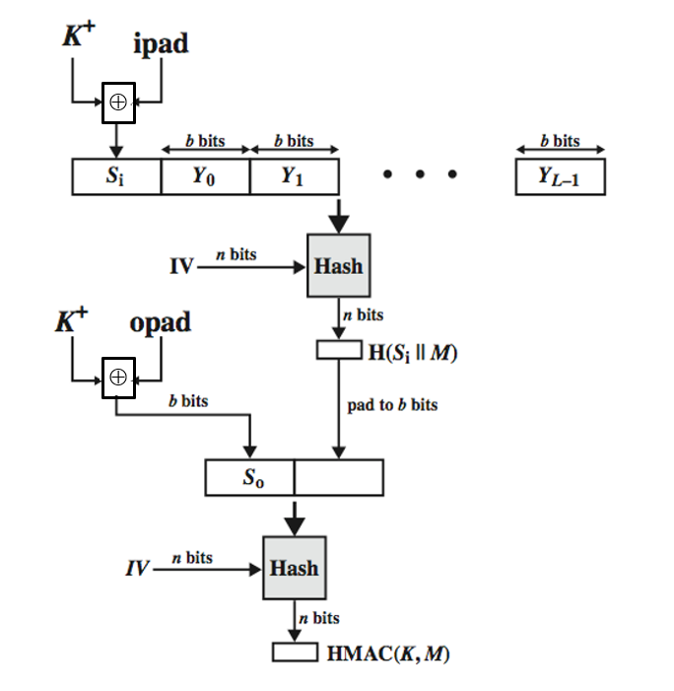
Keyed Hash Functions as MACs
want a MAC based on a hash function
because hash functions are generally faster
crypto hash function code is widely available
hash includes a key along with message
original proposal:
KeyedHash = Hash(Key|Message)
some weaknesses were found with this
eventually led to development of HMAC
have well understood cryptographic analysis of authentication mechanism strength
uses hash function on the message:
HMAC_{K}(M)= Hash[(K⁺ ⊕ opad) ||Hash[(K⁺ ⊕ ipad) || M)] ]
where K⁺ is the key padded out to size
opad, ipad are specified padding constants
overhead is just 3 more hash calculations than the message needs alone
any hash function can be used
proved security of HMAC relates to that of the underlying hash algorithm

Slide 30
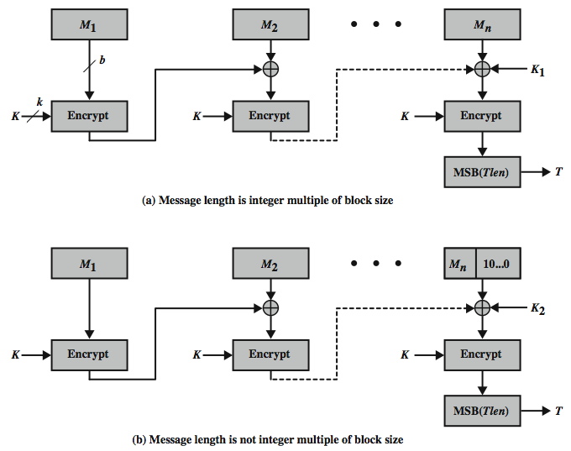
Using Symmetric Ciphers for MACs
can use any block cipher chaining mode and use final block as a MAC
Data Authentication Algorithm (DAA) is a widely used MAC based on DES-CBC
using IV=0 and zero-pad of final block
encrypt message using DES in CBC mode
and send just the final block as the MAC
or the leftmost M bits (16≤M≤64) of final block
but final MAC is now too small for security
has message size limitation
can overcome using 2 keys & padding
thus forming the Cipher-based Message Authentication Code (CMAC)

Slide 31
Authenticated Encryption
simultaneously protect confidentiality and authenticity of communications
often required but usually separate
Authenticated encryption (AE) is a term used to describe encryption systems that simultaneously protect confidentiality and authenticity (integrity) of communications.
Many applications and protocols require both forms of security, but until recently the two services have been designed separately.
There are four common approaches to providing both confidentiality and encryption for a message M
approaches
Hash-then-encrypt: E(K, (M || H(M))
MAC-then-encrypt: E(K2, (M || MAC(K1, M))
Encrypt-then-MAC: (C=E(K2, M), T=MAC(K1, C)
Encrypt-and-MAC: (C=E(K2, M), T=MAC(K1, M)
decryption /verification straightforward

Slide 32
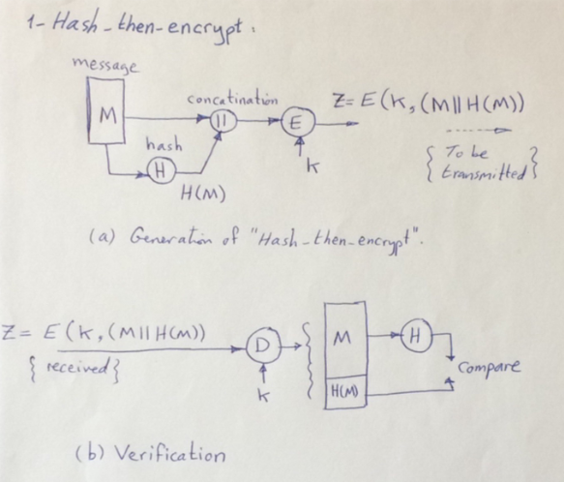
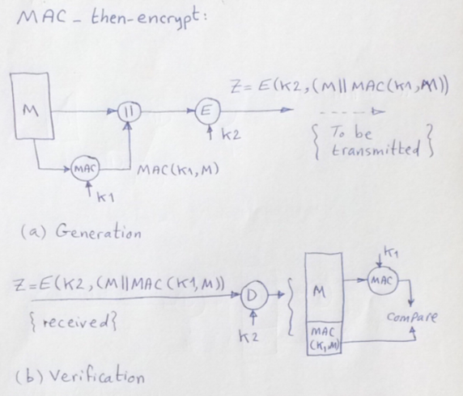
Authenticated Encryption Approaches
Hash-then-encrypt: E(K, (M || H(M))
First compute the cryptographic hash function over M as:
h = H(M).
Then encrypt the message plus hash function: E(K, (M || h)
MAC-then-encrypt: E(K2, (M || MAC(K1, M))
Use two keys.
First authenticate the plaintext by computing the MAC value as:
T = MAC(K1, M).
Then encrypt the message plus tag:
E(K2, (M || T)

Slide 33
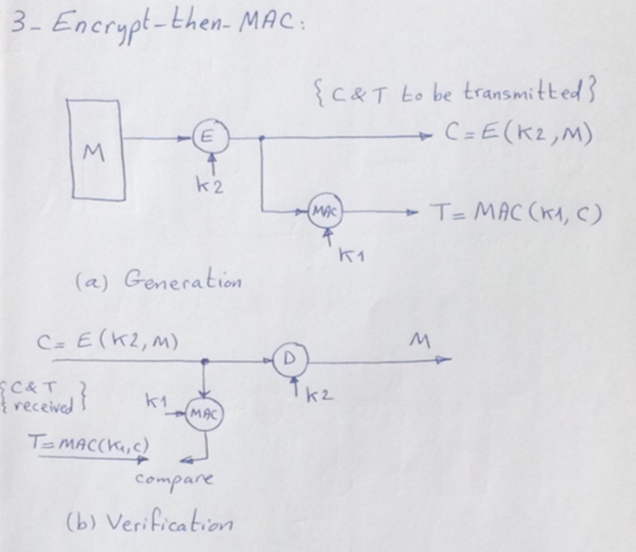
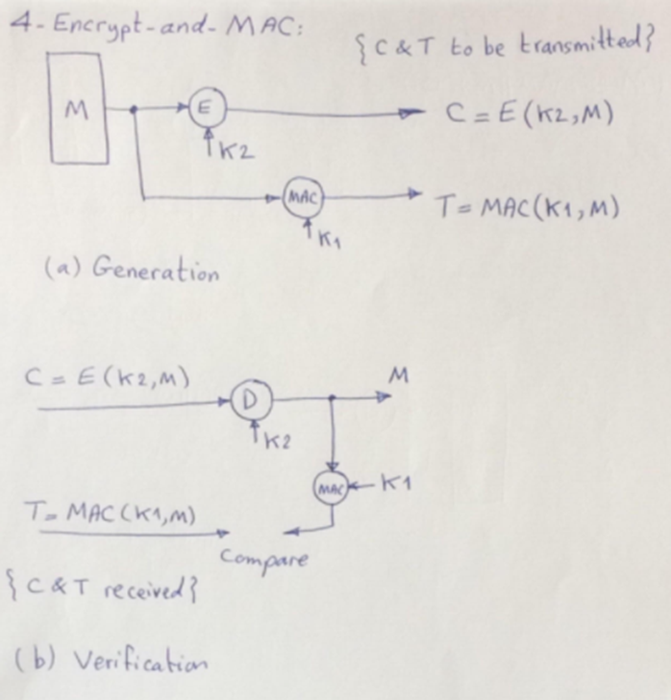
Authenticated Encryption Approaches
Encrypt-then-MAC: (C=E(K2, M), T=MAC(K1, C)
Use two keys.
First encrypt the message to yield the ciphertext:
C = E(K2, M).
Then authenticate the ciphertext with
T = MAC(K1, C) to yield the pair (C, T)
Encrypt-and-MAC: (C=E(K2, M), T=MAC(K1, M)
Use two keys.
Encrypt the message to yield the ciphertext:
C = E(K2, M).
Authenticate the plaintext with T = MAC(K1, M) to yield the pair (C, T).

Slide 34
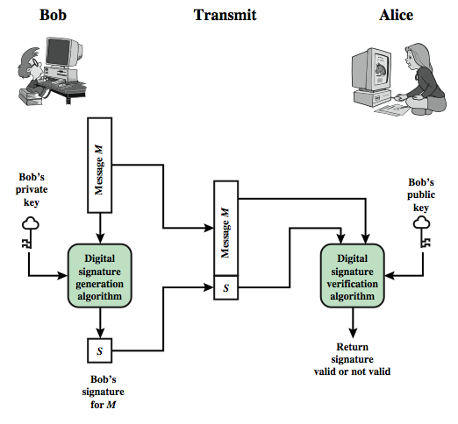
Digital Signatures
digital signatures provide the ability to:
verify author, date & time of signature
authenticate message contents
be verified by third parties to resolve disputes
hence include authentication function with additional capabilities
Requirements:
must depend on the message signed
must use information unique to sender
to prevent both forgery and denial
must be relatively easy to produce
must be relatively easy to recognize & verify
be computationally infeasible to forge
with new message for existing digital signature
with fraudulent digital signature for given message
be practical save digital signature in storage

Slide 35
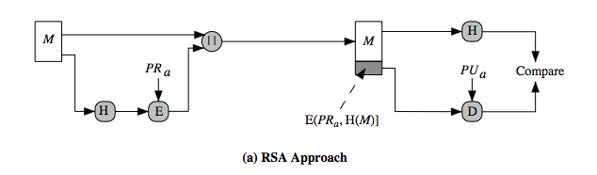
Direct Digital Signatures
involve only sender & receiver
assumed receiver has sender’s public-key
digital signature made by sender signing entire message or hash with private-key
can encrypt using receiver's public-key
important that sign first then encrypt message & signature
security depends on sender’s private-key
Digital Signature Standard (DSS)
uses the SHA hash algorithm
DSS is the standard, DSA is the algorithm
DSA is digital signature only unlike RSA which is a public-key technique
Digital Signature Algorithm (DSA)
creates a 320-bit signature with 512–1024-bit security
smaller and faster than RSA
a digital signature scheme only
security depends on difficulty of computing discrete logarithms

Slide 36
Key Management and Distribution
Symmetric schemes require both parties to share a common secret key.
Issue is how to securely distribute this key whilst protecting it from others.
Frequent key changes are usually desirable to limit the amount of data compromised if an attacker learns the key.
Often secure system failures are due to a break in the key distribution scheme.
Symmetric Key Distribution
Given parties A and B, key distribution can be achieved in several ways:
A can select a key and physically deliver it to B
A third party can select the key and physically deliver it to A and B
If A and B have previously and recently used a key, one party can transmit the new key to the other, encrypted using the old key
If A and B each has an encrypted connection to a third-party C, C can deliver a key on the encrypted links to A and B
Symmetric Key Distribution Using Public Keys:
public key cryptosystems are inefficient
so almost never use for direct data encryption because symmetric key cryptosystems are much faster.
rather public key cryptosystems are used to encrypt secret keys for distribution.

Slide 37
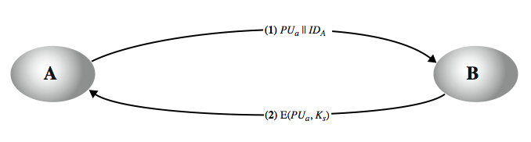
Key Hierarchy
session key
temporary key
used for encryption of data between users
for one logical session then discarded
master key
used to encrypt session keys
shared by user & key distribution center
Simple Secret Key Distribution
allows secure communications
no keys before/after exist (only for the session)
A generates a public/private key pair {PUa, PRa} and transmits a message to B consisting of PUa and an identifier of A, IDA.
B generates a secret key, Ks, and transmits it to A, encrypted with A's public key.
A computes D(PRa, E(PUa, Ks)) to recover the secret key. Because only A can decrypt the message, only A and B will know the identity of Ks.
A discards PUa and PRa and B discards PUa.

Slide 38
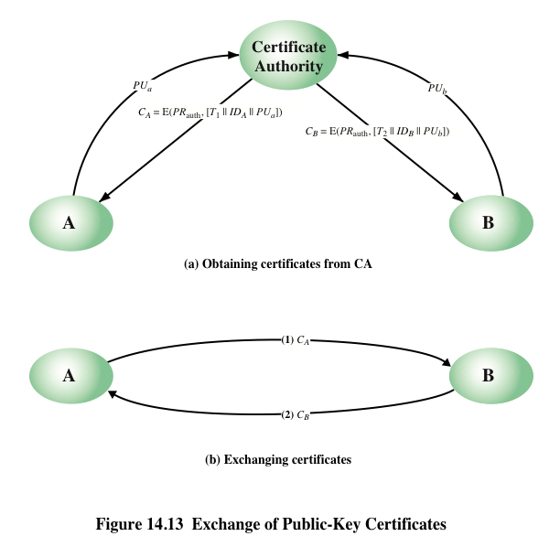
Distribution of Public Keys
Several techniques have been proposed for the distribution of public keys. Virtually all these proposals can be grouped into the following general schemes:
Public announcement
Publicly available directory
Public-key authority
Public-key certificates
certificates allow key exchange without real-time access to public-key authority
a certificate binds identity to public key, usually with other information such as period of validity, rights of use etc.
with all contents signed by a trusted Public-Key or Certificate Authority (CA)
can be verified by anyone who knows the public-key authorities public-key

Slide 39
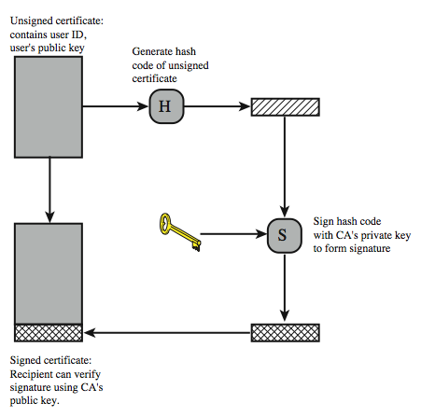
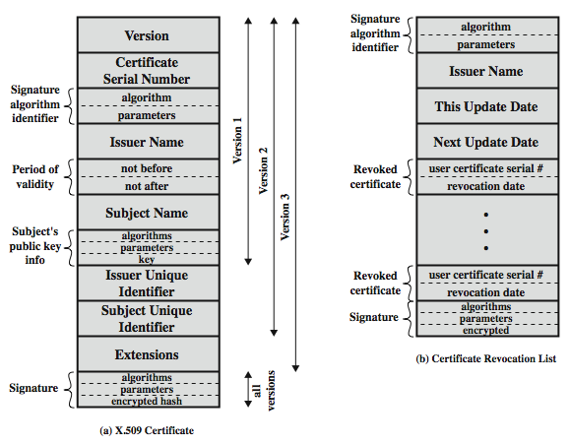
X.509 Authentication Service
part of CCITT X.500 directory service standards
distributed servers maintaining user info database
defines framework for authentication services
directory may store public-key certificates
with public key of user signed by certification authority
also defines authentication protocols
uses public-key crypto & digital signatures
algorithms not standardised, but RSA recommended
X.509 Certificates
have 3 versions
issued by a Certification Authority (CA), containing:
version V (1, 2, or 3)
serial number SN (unique within CA) identifying certificate
signature algorithm identifier AI
issuer X.500 name CA)
period of validity TA (from - to dates)
subject X.500 name A (name of owner)
subject public-key info Ap (algorithm, parameters, key)
issuer unique identifier (v2+)
subject unique identifier (v2+)
extension fields (v3)
signature (of hash of all fields in certificate)
notation CA<<A>> denotes certificate for A signed by CA

Slide 40
Obtaining a Certificate
User certificates generated by a CA have the following characteristics:
Any user with access to the public key of the CA can verify the user public key that was certified
No party other than the certification authority can modify the certificate without this being detected
Because certificates are unforgeable, they can be placed in a directory without the need for the directory to make special efforts to protect them
In addition, a user can transmit his or her certificate directly to other users
Once B is in possession of A’s certificate, B has confidence that messages it encrypts with A’s public key will be secure from eavesdropping and that messages signed with A’s private key are unforgeable
Certificate Revocation:
certificates have a period of validity
may need to revoke before expiry, eg:
user's private key is compromised
user is no longer certified by this CA
CA's certificate is compromised
CA’s maintain list of revoked certificates
the Certificate Revocation List (CRL)
users should check certificates with CA’s CRL

Slide 41
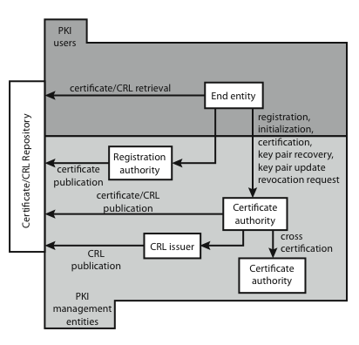
X.509 Version 3
has been recognised that additional information is needed in a certificate
email/URL, policy details, usage constraints
rather than explicitly naming new fields defined a general extension method
extensions consist of:
extension identifier
criticality indicator
extension value
Certificate Extensions
key and policy information
convey info about subject & issuer keys, plus indicators of certificate policy
certificate subject and issuer attributes
support alternative names, in alternative formats for certificate subject and/or issuer
certificate path constraints
allow constraints on use of certificates by other CA’s

Slide 42
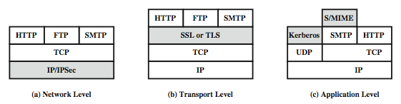
Web Traffic Security Approaches
Several approaches to providing Web security are possible. The various approaches that have been considered are similar in the services they provide and, to some extent, in the mechanisms that they use, but they differ with respect to their scope of applicability and their relative location within the TCP/IP protocol stack.

Slide 43
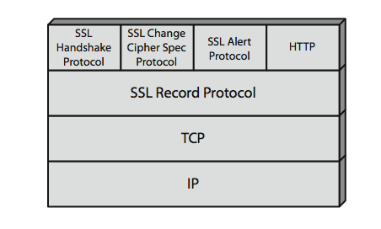
SSL (Secure Socket Layer)
transport layer security service
originally developed by Netscape
version 3 designed with public input
subsequently became Internet standard known as TLS (Transport Layer Security)
uses TCP to provide a reliable end-to-end service
SSL has two layers of protocols
SSL connection
a transient, peer-to-peer, communications link
associated with one SSL session
SSL session
an association between client & server
created by the Handshake Protocol
define a set of cryptographic parameters
may be shared by multiple SSL connections

Slide 44
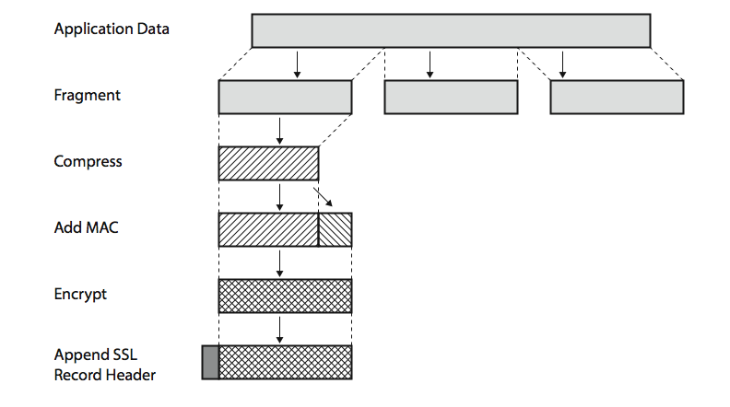
SSL Record Protocol Services
confidentiality
using symmetric encryption with a shared secret key defined by Handshake Protocol
can use several encryption ciphers such as: AES, IDEA, RC2-40, DES-40, DES, 3DES, Fortezza, RC4-40, RC4-128
message is compressed before encryption
message integrity
using a MAC with shared secret key
like HMAC but with different padding

Slide 45
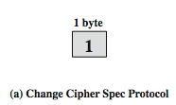
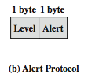
SSL Protocols
SSL Change Cipher Spec Protocol
one of 3 SSL specific protocols which use the SSL Record protocol
a single message causes pending state to become current
hence updating the cipher suite in use
SSL Alert Protocol
conveys SSL-related alerts to peer entity
Severity warning or fatal
specific alert
fatal: unexpected message, bad record mac, decompression failure, handshake failure, illegal parameter
warning: close notify, no certificate, bad certificate, unsupported certificate, certificate revoked, certificate expired, certificate unknown
compressed & encrypted like all SSL data

Slide 46
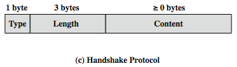
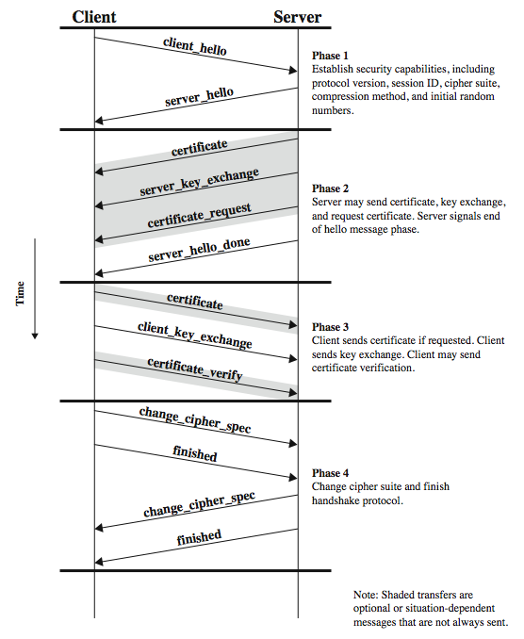
SSL Handshake Protocol
allows server & client to:
authenticate each other
to negotiate encryption & MAC algorithms
to negotiate cryptographic keys to be used
comprises a series of messages in four phases
Establish Security Capabilities
Server Authentication and Key Exchange
Client Authentication and Key Exchange
Finish

Slide 47
Cryptographic Computations
master secret creation
a one-time 48-byte value
generated using secure key exchange (RSA / Diffie-Hellman) and then hashing information.
generation of cryptographic parameters
client write MAC secret
a server write MAC secret
a client write key
a server write key
a client write IV
and a server write IV
these 6 secrets are generated by hashing the master secret using a simple algorithm and a hash function.

Slide 48
TLS (Transport Layer Security)
like SSLv3
with minor differences
in record format version number
uses HMAC for MAC
a pseudo-random function expands secrets
based on HMAC using SHA-1 or MD5
has additional alert codes
some changes in supported ciphers
changes in certificate types & negotiations
changes in cryptographic computations & padding

Slide 49
HTTPS
HTTPS (HTTP over SSL)
combination of HTTP & SSL/TLS to secure communications between browser & server
Use port 443 rather than 80 for http
Encrypts URL, document contents, form data, cookies, HTTP headers
For HTTPS, the agent acting as the HTTP client also acts as the TLS client.
connection initiation
TLS handshake then HTTP request(s)
connection closure
have “Connection: close” in HTTP record
TLS level exchange close_notify alerts
can then close TCP connection
must handle TCP close before alert exchange sent or completed

Slide 50
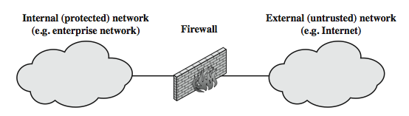
What is a Firewall?
A general model of firewall use on the security perimeter, as a choke point for traffic between the external less-trusted Internet and the internal more trusted private network.
Firewall limitations , a firewall:
Cannot protect against attacks that bypass the firewall
May not protect fully against internal threats, such as a disgruntled employee or an employee who unwittingly cooperates with an external attacker
Cannot guard against wireless communications between local systems on different sides of the internal firewall
A laptop, PDA, or portable storage device may be used and infected outside the corporate network, and then attached and used internally

Slide 51
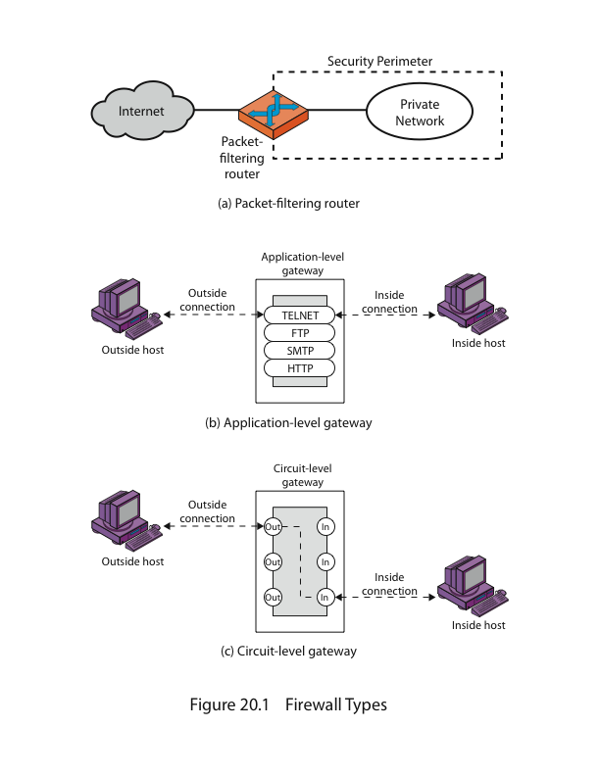
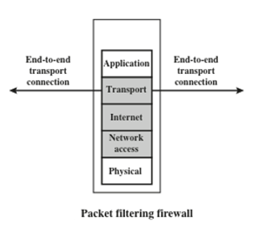
Types of Firewalls
Packet Filtering Firewall
A packet filtering firewall applies a set of rules to each incoming and outgoing IP packet and then forwards or discards the packet.
The firewall is typically configured to filter packets going in both directions (from and to the internal network). Filtering rules are based on information contained in a network packet:
Source IP address: The IP address of the system that originated the IP packet • Destination IP address: The IP address of the system the IP packet is trying to reach
Source and destination transport-level address: The transport-level (e.g., TCP or UDP) port number, which defines applications such as SNMP or TELNET
IP protocol field: Defines the transport protocol
Note that the firewall passes the TCP connection between the inside and outside hosts without breaking it
Attacks and Countermeasures
IP address spoofing : The intruder(attacker) transmits packets from the outside with a source IP address field containing an address of an internal host
Countermeasure is to discard packets with an inside source address if the packet arrives on an external interface
Tiny fragment attacks: The intruder uses the IP fragmentation option to create extremely small fragments and force the TCP header information into a separate packet fragment
Countermeasure is to enforce a rule that the first fragment of a packet must contain a predefined minimum amount of the transport header

Slide 52
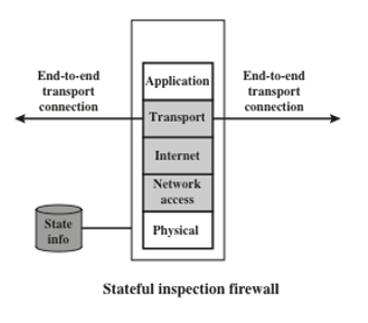
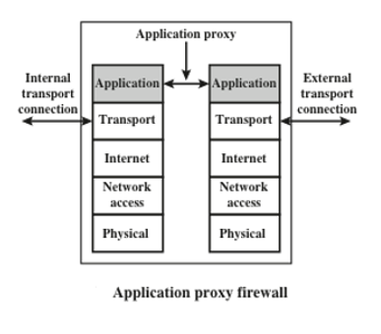
Cont. Types of Firewalls
Stateful Firewall
Application Proxy Firewall
Also called an application proxy
Acts as a relay of application-level traffic
If the gateway does not implement the proxy code for a specific application, the service is not supported and cannot be forwarded across the firewall
The gateway can be configured to support only specific features of an application that the network administrator considers acceptable while denying all other features
Tend to be more secure than packet filters
Disadvantage: The additional processing overhead on each connection

Slide 53
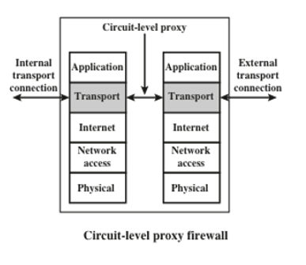
Cont. Types of Firewalls
Circuit-Level Proxy Firewall
Also called circuit-level proxy
Can be a stand-alone system or it can be a specialized function performed by an application-level gateway for certain applications
Does not permit an end-to-end TCP connection
The security function consists of determining which connections will be allowed
Typical use is a situation in which the system administrator trusts the internal users
Can be configured to support application-level or proxy service on inbound connections and circuit-level functions for outbound connections

Slide 54
Host-Based Firewall
A software module used to secure an individual host
Is available in many operating systems or can be provided as an add-on package
Filters and restricts the flow of packets
Common location is a server
Advantages:
a) Filtering rules can be tailored to the host environment
b) Protection is provided independent of topology
c) Used in conjunction with stand-alone firewalls
d) Provides an additional layer of protection

Slide 55
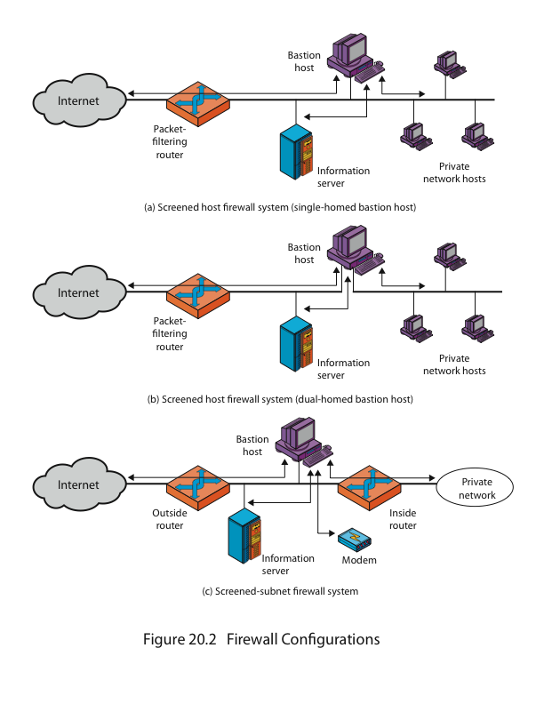
Firewall Configurations
In general, a firewall is positioned to provide a protective barrier between an external, potentially untrusted source of traffic and an internal network. With that general principle in mind, a security administrator must decide on the location and on the number of firewalls needed.
In addition to the use of a simple configuration consisting of a single system, more complex configurations are possible and indeed more common.
Common Configurations:
Single-Homed Bastion Host (SHBH)
Note that if an intruder compromises the packet-filtering router, he can by-pass the bastion host and pass any external bogus traffic directly to the internal private network servers and hosts.
In the “screened host firewall, single-homed bastion configuration”, the firewall consists of two systems:
a packet-filtering router - allows Internet packets to/from bastion only
a bastion host - performs authentication and proxy functions
This configuration has greater security, as it implements both packet-level & application-level filtering
It forces an intruder to generally penetrate two separate systems to compromise internal security.
It also affords flexibility in providing direct Internet access to specific internal servers (eg web) if desired

Slide 56
Cont. Common Firewall Configurations
Dual-Homed Bastion Host (DHBH)
Note that if an intruder compromises the packet-filtering router, he must also compromise the bastion host to access the internal private network hosts. Accessing the internal network must go through the bastion host .
This configuration physically separates the external and internal networks, ensuring two systems must be compromised to breach security.
The advantages of dual layers of security are also present here.
Again, an information server or other hosts can be allowed direct communication with the router if this is in accordance with the security policy, but are now separated from the internal network.
Screened Subnet Firewall (SSFW)
Both the Internet and the internal network have access to hosts on the screened subnet, but traffic across the screened subnet is blocked.
There are now three levels of defense to thwart intruders
This configuration is the most secure shown.
It has two packet-filtering routers, one between the bastion host and the Internet and the other between the bastion host and the internal network, creating an isolated subnetwork (screened subnet).
This screened subnet may consist of simply the bastion host but may also include one or more information servers and modems for dial-in capability.
Typically, both the Internet and the internal network have access to hosts on the screened subnet, but traffic across the screened subnet is blocked.

Slide 57
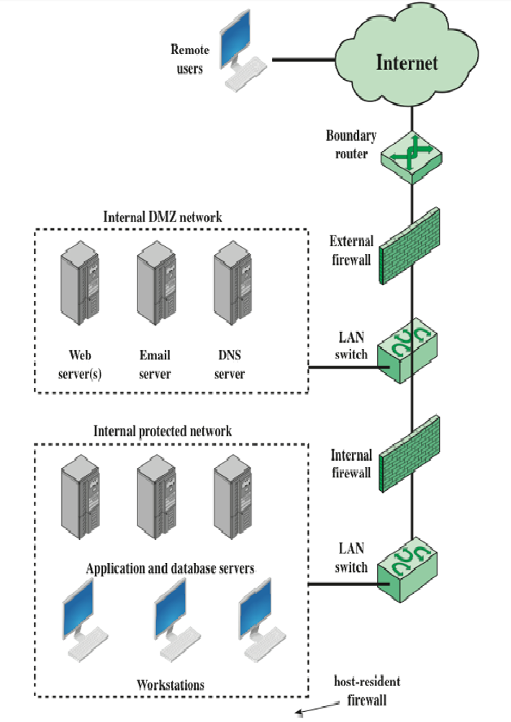
Demilitarized Zone (DMZ) Networks
This is a “screened subnet”, located between an internal and an external firewall.
An external firewall is placed at the edge of a local or enterprise network, just inside the boundary router that connects to the Internet or some wide area network (WAN).
One or more internal firewalls protect the bulk of the enterprise network.
Systems that are externally accessible but need some protections are usually located on DMZ networks. Typically, the systems in the DMZ require or foster external connectivity, such as a corporate Web site, an e-mail server, or a DNS (domain name system) server.
The external firewall provides a measure of access control and protection for the DMZ systems consistent with their need for external connectivity. The external firewall also provides a basic level of protection for the remainder of the enterprise network
In this type of configuration, internal firewalls serve three purposes:
The internal firewall adds more stringent filtering capability, compared to the external firewall, to protect enterprise servers and workstations from external attack.
The internal firewall provides two-way protection with respect to the DMZ:
It protects the remainder of the network from attacks launched from DMZ systems.
It also protects DMZ systems from attack by internal hosts.
Multiple internal firewalls can be used to protect portions of the internal network from each other.
A common practice is to place the DMZ on a different network interface on the external firewall from that used to access the internal networks.

Slide 58
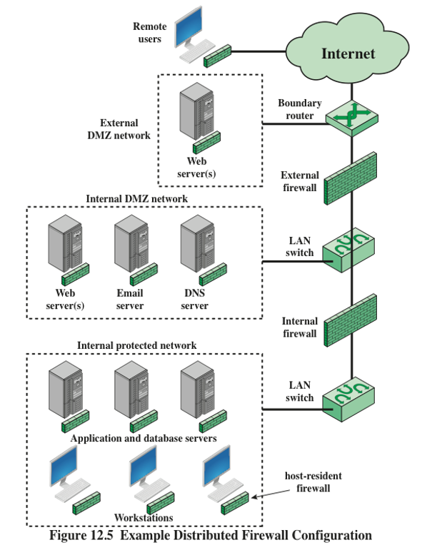
A Distributed Firewall Configuration
Types:
External DMZ network
Internal DMZ network
Internal protected network
A distributed firewall configuration involves stand-alone firewall devices plus host-based firewalls working together under a central administrative control.
Administrators can configure host-resident firewalls on hundreds of servers and workstations as well as configure personal firewalls on local and remote user systems. These firewalls protect against internal attacks and provide protection tailored to specific machines and applications.
Stand-alone firewalls provide global protection, including internal firewalls and an external firewall, as discussed previously.

